Slide 1




EV BATTERY EXPLORER

Slide 2

PROJECT IDEA
The website educates users about various types of batteries used in electric vehicles
Provides clear, interactive information on battery features and technology.
Designed to offer a simple, engaging, and user-friendly learning experience.

Slide 3
TECHNOLOGIES USED
HTML : To create the basic structure and content of the website.
CSS : To style the website, making it visually appealing and responsive.
JavaScript : To add interactivity by dynamically rendering battery information and enabling user actions like toggling descriptions.

Slide 4
HTML
Header Tag : Contains website title and introduction paragraph
Nav Tag: Contains links for Home, About, Contact
Main Tag : Contains section that shows cards for each battery type that will be loaded via JavaScript
Footer Tag : Copyright

Slide 5
CSS
Layout Design:
For mobile layout use a stacked layout for easy vertical scrolling using flex container with vertical direction
For desktop layout use CSS Grid for a multi-column layout on wider screens.
Flexbox will be used inside cards and headers for alignment.
Responsive Styling:
Optimized for mobile, tablet, and desktop.
Layout adjusts automatically with media queries.
Color Themes and Card Design:
Use shadows for depth, rounded corners and inner spacing.
Different accent colors for each battery type.
Helps visually group and identify batteries.
Interactive Card Effects:
Cards highlight on hover.
Toggle to show/hide descriptions interactively.
Smooth Animations
Used CSS transitions and transforms.
Makes the interface more engaging and modern.

Slide 6
JAVASCRIPT
Battery Data Structure: Battery types and their features are stored in a structured JavaScript object, similar to JSON format.
Dynamic Card Creation: The battery information is dynamically rendered as cards on the webpage using JavaScript DOM manipulation.
Interactive Toggle Effect: Users can click on a card to toggle visibility of the full battery description.
Event Handling: Manages user clicks to control toggle actions and interactive behavior on the website.

Slide 7
WEBSITE FEATURES AND FUNCTIONALITY
Displays different electric vehicle battery types with names and short description
Users browse different battery types through cards.
Users can click on a card to show or hide full battery descriptions.
Works smoothly on mobile, tablet, and desktop screens.
Hover effects, smooth transitions, and colored cards.
All battery data is generated dynamically using JavaScript.

Slide 8
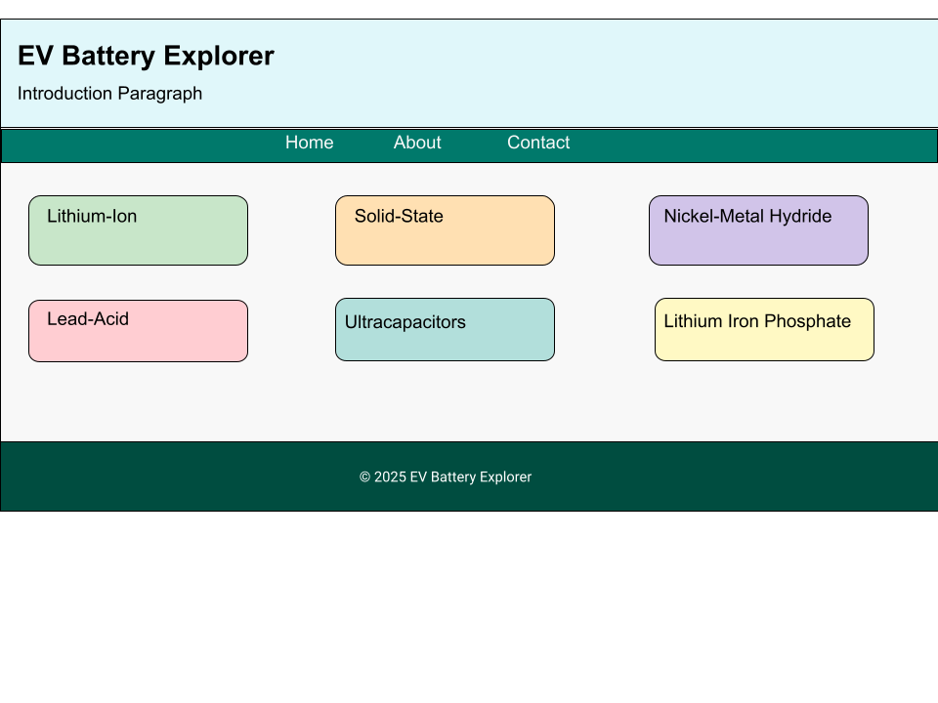
DESIGN PLAN
This is a simple mockup created by Google Docs

Slide 9
THANK YOU

